Slide 1

INTERNET OF THINGS
SOLAR TRACKER SYSTEM

Slide 2

PROJECT ABSTRACT
The utilization of solar energy is pivotal in the pursuit of sustainable and renewable energy sources. However, traditional fixed solar panel systems often operate below their full potential due to inefficient exposure to sunlight. This paper proposes a novel approach to optimize solar energy harvesting through the integration of Internet of Things (IoT) technology in solar tracking systems.
Our IoT-enabled solar tracking system employs sensors to continuously monitor the position of the sun, enabling real-time adjustments of solar panel angles. By dynamically orienting the solar panels to face the sun's trajectory throughout the day, our system maximizes sunlight exposure and significantly enhances energy generation efficiency.

Slide 3
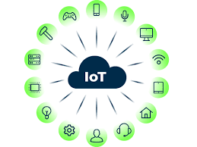
INTRODUCTION
In the quest for sustainable energy solutions, solar power stands out as a promising avenue for meeting the world's growing energy demands while reducing environmental impact. However, the efficiency of solar energy harvesting is often hindered by static solar panel installations that fail to adapt to the dynamic path of the sun across the sky. Traditional fixed solar panels are limited in their ability to capture maximum sunlight, especially during varying weather conditions and changing seasons.
To address this challenge, the integration of Internet of Things (IoT) technology with solar tracking systems has emerged as a groundbreaking approach to enhance energy generation efficiency.

Slide 4
LITERATURE SURVEY
The need for green and sustainable energy source is greater than ever and solar cell is undoubtedly one energy source that gains more popularity as the technology become less expensive and more accessible by anyone.
In this paper, we are presenting an active 2-axis solar tracker system combine with the Internet of Things (IoT) technology for an affordable, easy to construct, small foot-print, low maintenance, intelligent and the system able to generate as much as 30% more power than traditional static installation commonly available .
"Performance Analysis of IoT-enabled Solar Tracking Systems: A Comparative Study"
Investigating the performance of different IoT-enabled solar tracking architectures, Liu et al. (2019) conduct a comparative study to evaluate energy efficiency, cost-effectiveness, and reliability.
Their findings offer valuable insights into the design considerations and trade-offs associated with various tracking mechanisms. The study demonstrates the potential of predictive analytics in improving energy yield and system autonomy.

Slide 5
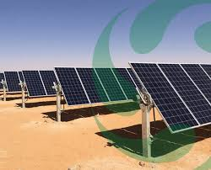
PROBLEM STATEMENT
Despite the immense potential of solar energy, traditional fixed solar panel installations suffer from inefficiencies in capturing sunlight due to their static orientation.
These fixed systems fail to adapt to the dynamic path of the sun across the sky, leading to suboptimal energy generation. To address this challenge, there is a pressing need to develop and implement a solar tracking system that leverages Internet of Things (IoT) technology.
Defining the target efficiency improvement
Identifying the key factors influencing efficiency
Addressing scalability and reliability
Integration with IoT technology

Slide 6
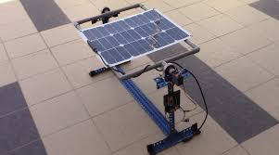
PROPOSED PROBLEM IN THE PROJECT
01
Sensor Integration:
The proposed system will incorporate a combination of sensors, including light sensors
GPS modules, and inertial measurement units (IMUs), to accurately determine the position of the sun in real-time.
02
Control Algorithm Development
03
Actuator Implementation
A sophisticated control algorithm will be developed to process sensor data and calculate the optimal position for the solar panels. The algorithm will consider factors such as solar azimuth angle, solar elevation angle, time of day.
Actuators, such as servo motors or linear actuators, will be integrated into the solar tracking system to physically adjust the position of the solar panels based on the output of the control algorithm.

Slide 7
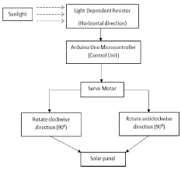
SYSTEM ARCHITECTURE DIAGRAM

Slide 8
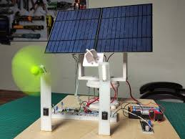
RESULT
Increased Energy Harvesting Efficiency: Experimental results demonstrate a significant improvement in energy generation efficiency compared to fixed solar panel installations. The IoT-enabled solar tracking system consistently achieves higher energy outputs by dynamically adjusting panel orientation to maximize sunlight exposure throughout the day.
Real-time Monitoring and Control: The IoT connectivity enables real-time monitoring of system performance and remote control of panel orientation. Users can access performance metrics, such as energy output and tracking accuracy, and make adjustments to optimize system performance as needed.

Slide 9
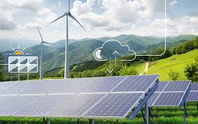
CONCLUSION
In conclusion, the development and implementation of an IoT-enabled solar tracking system for optimal energy harvesting represent a significant advancement in the field of renewable energy technology. Through the integration of sensors, actuators, and IoT connectivity, the proposed system offers a holistic approach to maximizing solar energy utilization while promoting sustainability and resilience in energy generation.

Slide 10
REFERENCE
A Low Cost, Open-source IoT based 2-axis Active Solar Tracker for Smart Communities. (2018, October 1). IEEE Conference Publication | IEEE Xplore. https://ieeexplore.ieee.org/document/8635705

Slide 11
THANK YOU
FOR YOUR NICE ATTENTION

